Slide 1
Race-day Nutrition
Karen Buxton
USAT Level III Coach
www.coachbuxton.com

Slide 2
Better nutrition, better performance
Choosing and eating the right foods can enhance performance
Provides fuel (glycogen) for the working muscles
Aids in recovery
Provides proper nutrients to build muscles & repair tissues that are broken down from the rigors of exercise
Notes:
The liver 70-100 (280 to 400 calories) grams of glycogen and the muscles holding 200-400 (800 to 1600 calories)grams

Slide 3
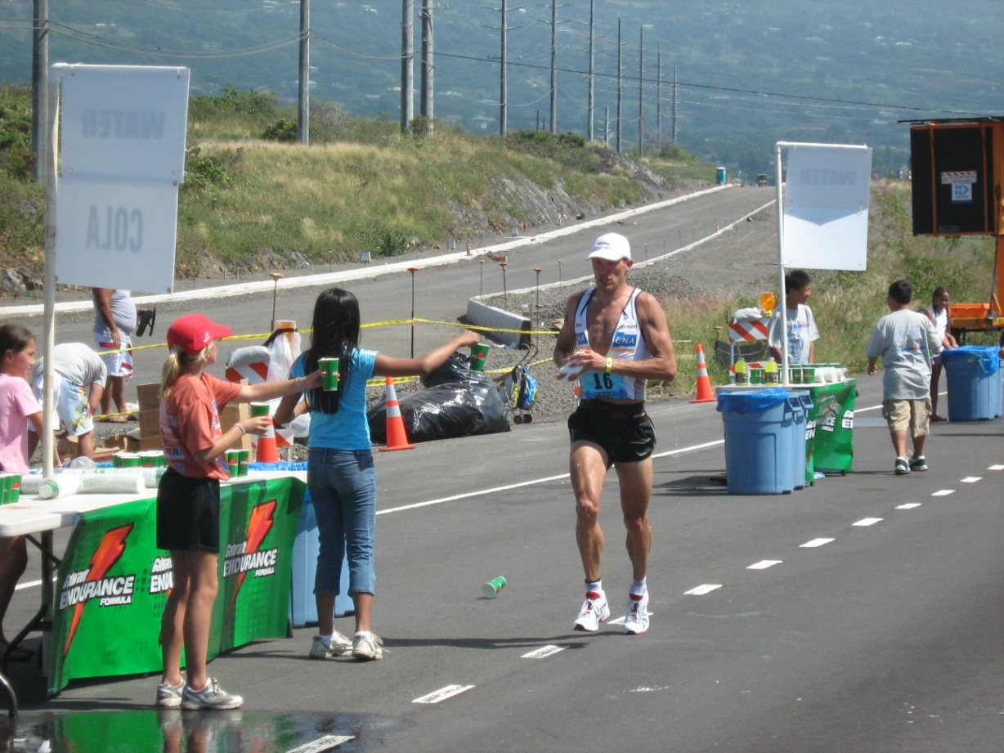
Goals, guidelines & choices
Pre-race
Race
Post-race

Slide 4
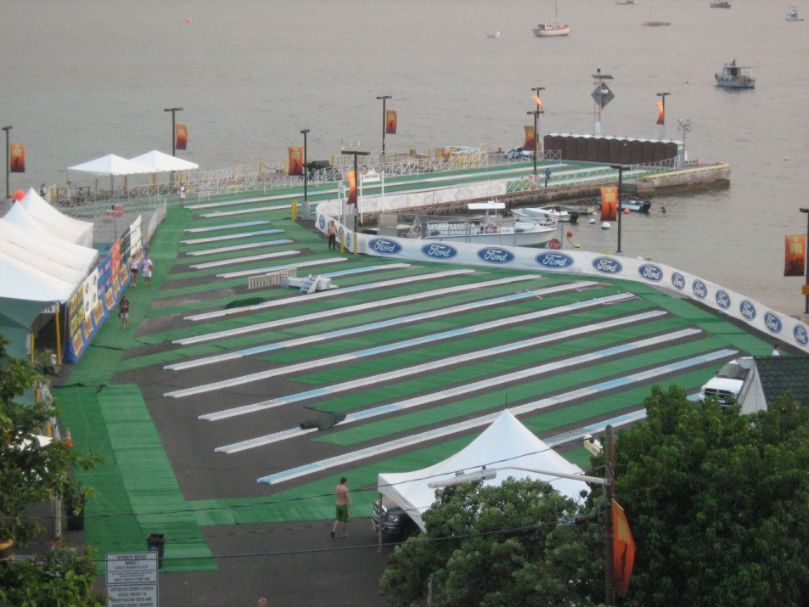
Pre-race goals
Satisfy hunger
Replenish CHO stores
Replenish body fluid levels
Optimize performance
Aid in post-race recovery

Slide 5
Pre-race guidelines
Increase salt intake a few days before the event
Take in 200 to 500 calories at least 2 hours prior to the event
Calories can be from liquid, solid or combo of both
Mostly CHO & low in fiber
Hydrate well with a “sport’s drink”
Sip on water prior to the event
Take in 8-12 ounces of a liquid CHO source ~10 minutes before the event start
Notes:
0.5 grams per 1 pound of body wt
1 gram of CHO = 4 cals
128 x .5 = 64 grams = 256 calories

Slide 6
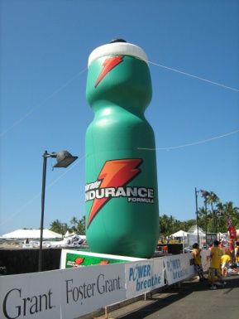
Pre-race choices
Meal replacement drinks—Boost, Ensure
Bars—Granola, Clif, Power
Oatmeal, cereal
Banana
Toast/bagel and peanut butter
Sports drinks—Gatorade, Accelerade, Ultrafuel, Carbo Pro, Infint Nutrition

Slide 7
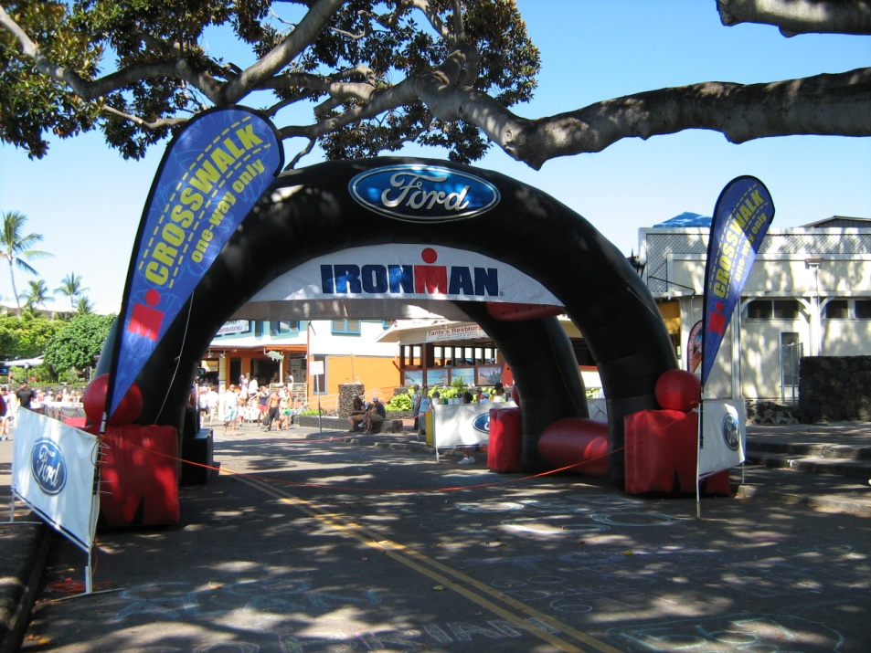
Race goals
Provide calories for working muscles
Keep hydrated and cool
Maintain electrolyte balance
Aid in recovery
Notes:
Main goal is to delay the onset of fatigue

Slide 8
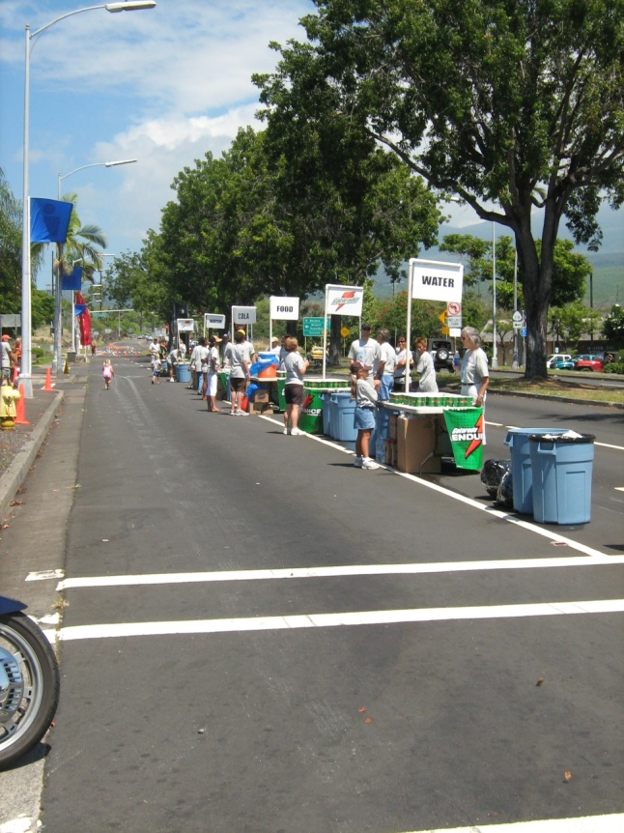
Race guidelines & choices
Less than 60 minutes
1.0 hours to 4.0 hours
just water
At least 20 ounces of fluid per hour
Sports drink and gels/water
Should aim for 200 to 300 calories per hour
Sodium intake ~ 1 gram per hour
Notes:
sodium in a beverage helps maintain the physiological drive to drink 2) in concert with glucose, enhances fluid absorption in the proximal small intestine 3) stimulates the rate and completeness of rehydration
7% CHO solution—higher concentrations slow gastric emptying and can cause upset

Slide 9
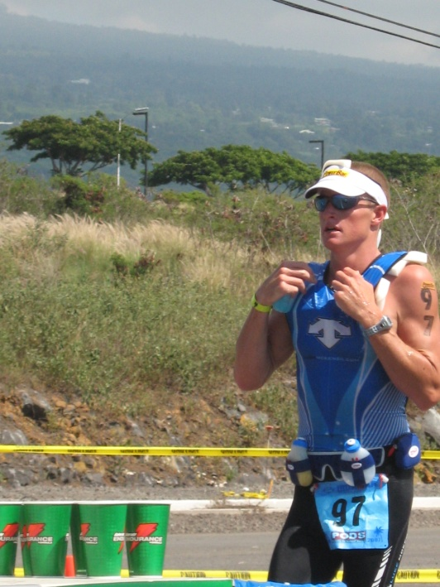
Guidelines continued
4.0 to 12.0 hours
12.0 on….
At least 20 ounces of fluid per hour
Sports drink and gels/water
Can introduce solid food
Should aim for 300 to 500 calories per hour
Sodium intake ~ 1 gram per hour
Same, but can add even more calories from solid food
Notes:
Carbohydrate from a single source, such as glucose, can only be oxidized at rates of approximately 60 g/h. When a combination of carbohydrates is ingested (e.g., glucose and fructose) oxidation rates of slightly more than 100 g/h can be achieved if large amounts of carbohydrate are ingested (e.g., > 140 g/h).

Slide 10
Common problems & causes
Problems
Causes
Nausea
Bloating
Abdominal cramping
Vomiting
Diarrhea
Malaise
Improper pacing
Too much fluid
Too many/few calories
Too much/little salt
Dehydration
Swallowing sea water
Notes:
Your brain needs relies on glucose in your blood for energy—helps you think clearly and concentrate well

Slide 11
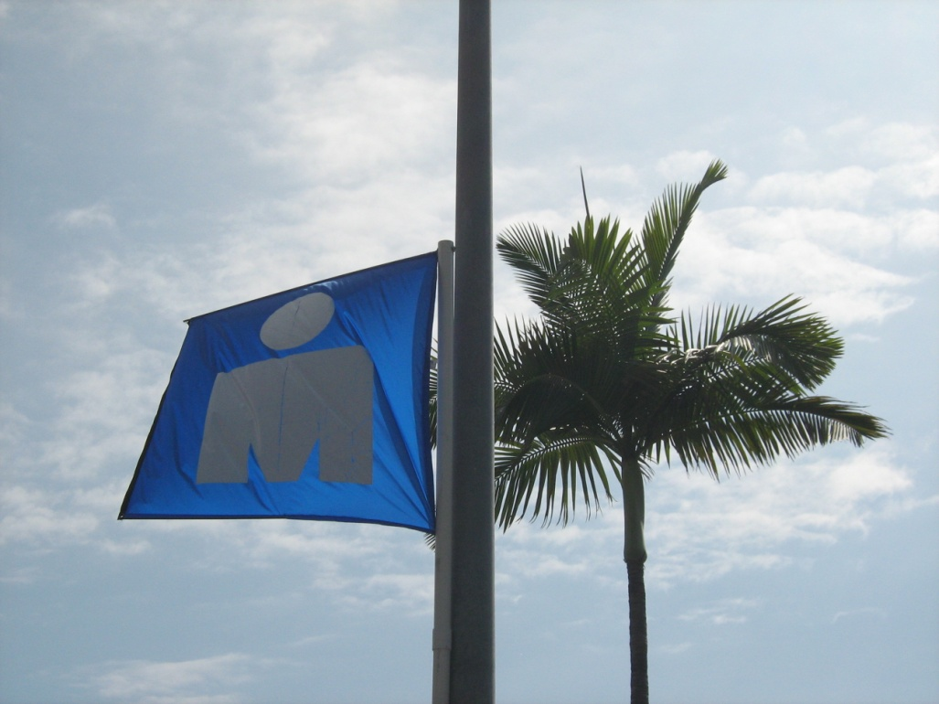
Post-race goals
Replace glycogen stores
Replace electrolytes
Provide protein for muscles
Rehydrate
Satisfy hunger

Slide 12
Post-race guidelines & choices
Within 30 minutes
Later…
~16 ounces of fluid for every pound lost
High CHO drink or solid food
Continue to hydrate and eat CHO
Okay to add protein
Extra salt on foods
“Listen to your body!”
Notes:
“recovery window” where glycogen uptake is faster

Slide 13
Links & books
Links
Books
Gatorade Sports Science Institute
http://www.gssiweb.com/
Caloriesperhour.com
http://caloriesperhour.com/index_burn.html
Infinit Nutrition
www.infinitnutrition.us
Sports Nutrition for Endurance Athletes—Monique Ryan
Nutrition for Health, Fitness & Sport—Melvin H. Williams
Dynamic Nutrition for Maximum Performance—Gastelu & Hatfield
Endurance Sports Nutrition—Suzanne Girard Eberle

Slide 14
Questions:
Karen Buxton
www.coachbuxton.com
karen@coachbuxton.com
336.255.5655

